Slide 1
Heat Treatment
19 Desember 2017

Slide 2
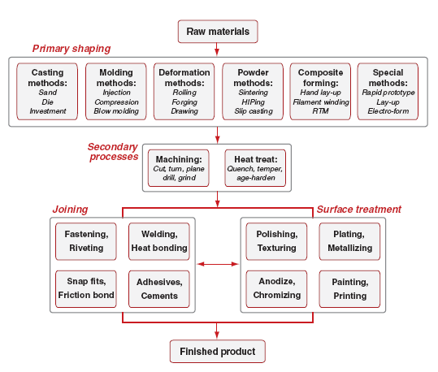
Proses Pengerjaan Bahan Teknik

Slide 3
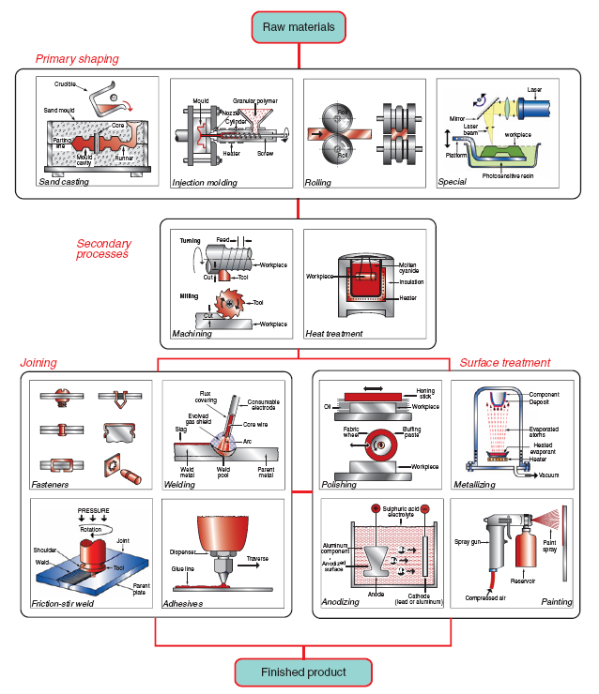

Slide 4
Heat Treatment
Annealing, is a heat treatment to increase its ductility and to make it more workable. It involves heating a material to above its glass transition temperature, maintaining a suitable temperature, and then cooling. Steel must be cooled slowly to anneal. The metal is softened and prepared for further work—such as shaping, stamping, or forming.

Slide 5
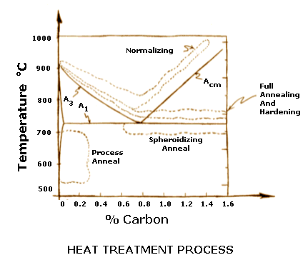
Annealing Temperature

Slide 6
Heat Treatment
Tempering/Aging is a process of heat treating, which is used to increase the toughness of iron-based alloys. Tempering is done by heating the metal to some temperature below the critical point for a certain period of time, then allowing it to cool in still air. In glass, tempering is performed by heating the glass and then quickly cooling the surface, increasing the toughness.

Slide 7
Heat Treatment
Quenching is the rapid cooling of a workpiece to obtain certain material properties. For instance, it can increasing the hardness of both alloys and plastics (produced through polymerization). In metallurgy, it is most commonly used to harden steel by introducing martensite, in which case the steel must be rapidly cooled through its eutectoid point, the temperature at which austenite becomes unstable.

Slide 8
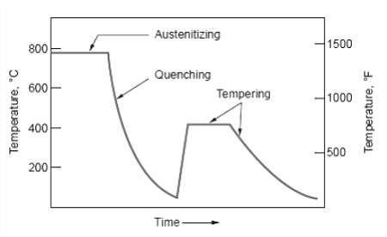

Slide 9
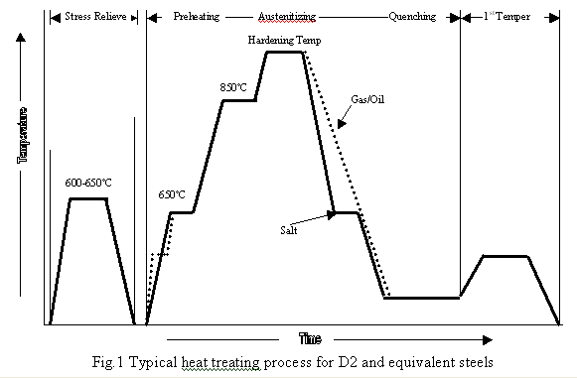

Slide 10
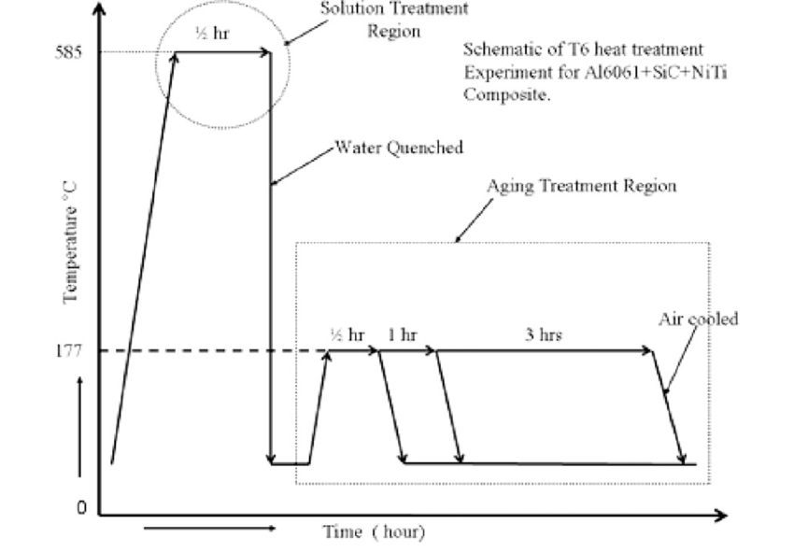

Slide 11
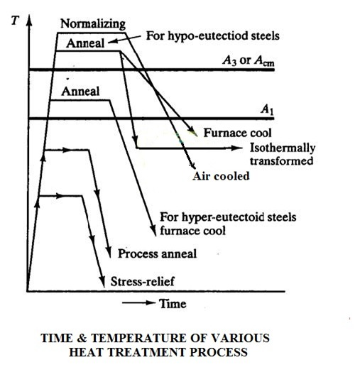

Slide 12
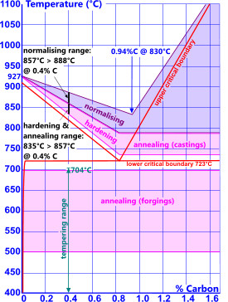

Slide 14
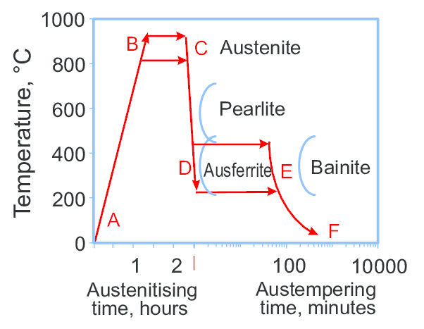

Slide 15
Tugas
Dikerjakan sendiri-sendiri, tulis sumbernya
Sertakan dengan gambar, kalau ada
Cari definisi:
Austenit
Pearlite
Bainite
Ferrite
Martensite
Dikumpulkan kolektif, paling telat Kamis, 28 Desember 2017 jam 15.00

Slide 16
Terima Kasih

